Slide 1
2019 Comprehensive Plan Amendments
Bellevue Planning Commission
Threshold Review Public Hearings April 24, 2019
Nicholas Matz AICP, Department of Community Development

Slide 2
2019 Annual Comprehensive Plan Amendments
Purpose
Receive the Threshold Review staff recommendation
Conduct a public hearing for each application
Hold a study session following each hearing, and make a recommendation via resolution for City Council action
Notes:
The Comprehensive Plan is Bellevue’s foundational policy document…an amendment to the Plan is a mechanism by which the City may modify its land use, development or growth policies.
Land Use Code (LUC) 20.30I.120 – Purpose
Overview of the review process:
Limited to an annual process under GMA
Threshold Review recommendations = proposed annual work program
Annual work program established when City Council acts on Planning Commission recommendations (June)

Slide 3
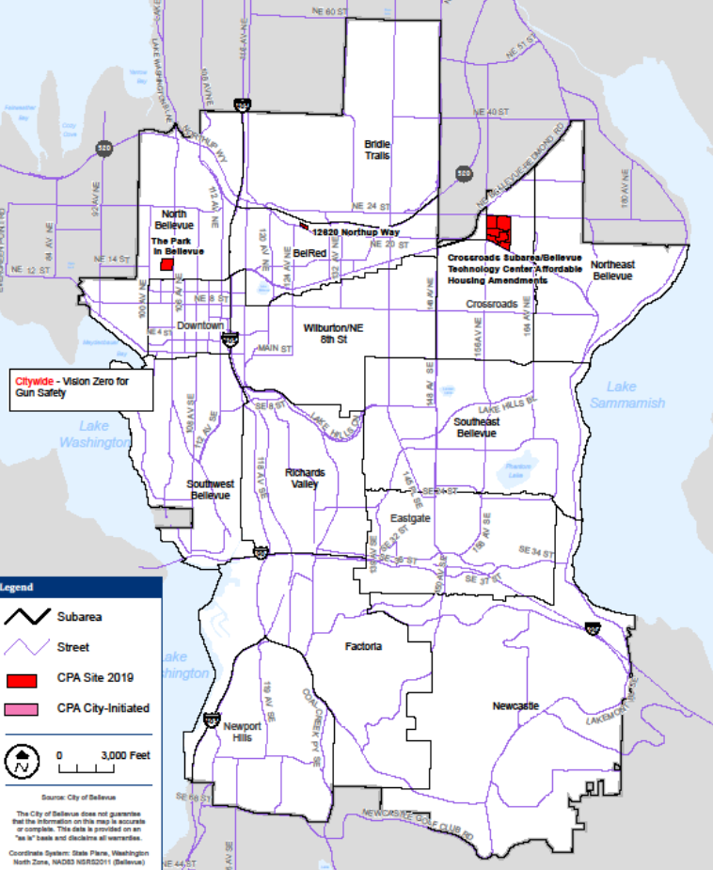
2019 Annual Comprehensive Plan Amendments
12620 Northup Way
Crossroads/Bellevue Technology Center
The Park in Bellevue
Notes:
Park in Bellevue
BTC
Both subject to Threshold Review hearing tonight
12620 Northup withdrawn
VZGS scheduled for May 22

Slide 4
2019 Annual Comprehensive Plan Amendments
Review Criteria (LUC 20.30I)
Appropriately addressed through the Plan
In compliance with the three-year limit rule
Does not raise policy issues outside the CPA
Can be reasonably reviewed within resources
Addresses significantly changed conditions
Geographic scope to match similar properties
Consistent with current general Plan policies
State law, court or admin decision requires CPA

Slide 5
The Park in Bellevue
2019 Annual Comprehensive Plan Amendments
Bellevue Planning Commission
Threshold Review Public Hearings April 24, 2019

Slide 6
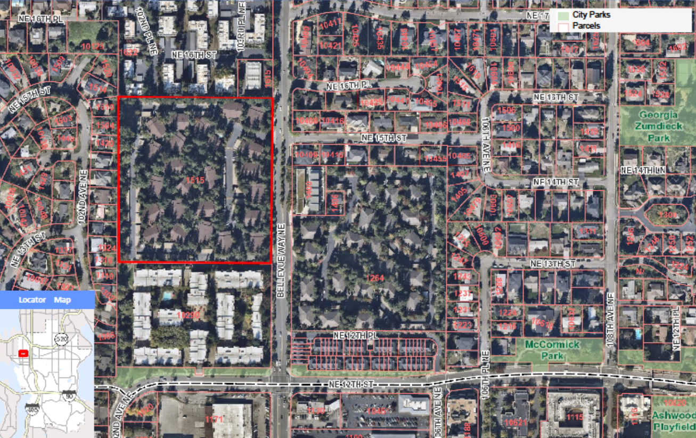
2019 Annual Comprehensive Plan Amendments
The Park in Bellevue (Applicant)
MF-M and MF-L to MF-UR*
Add an MF-UR definition to the Glossary
Delete S-NB-39 from North Bellevue Subarea Plan
* This designation does not exist

Slide 7
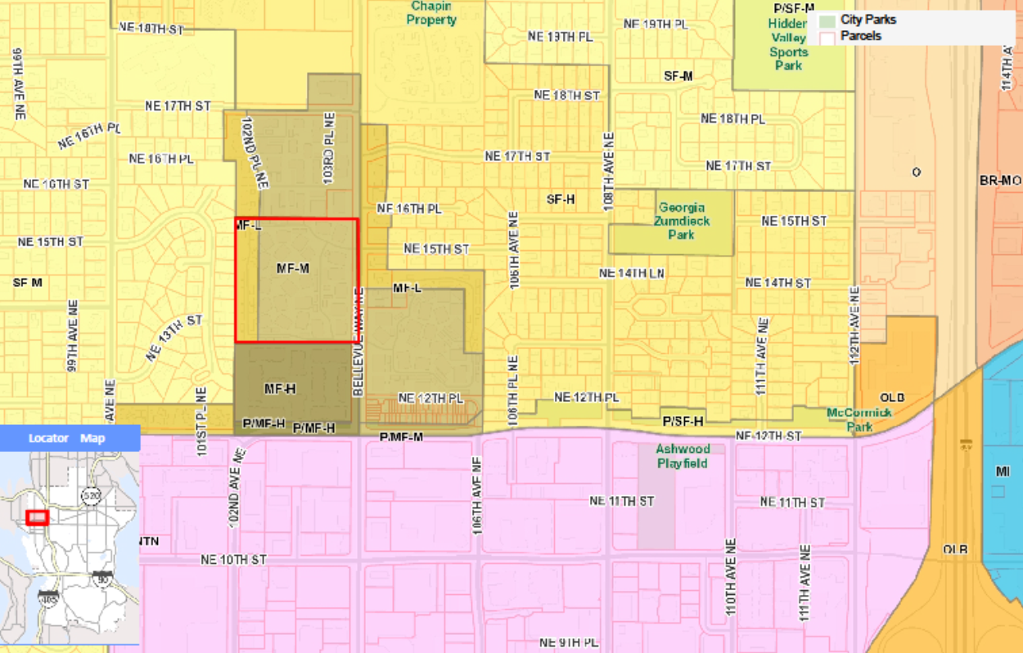
2019 Annual Comprehensive Plan Amendments
The Park in Bellevue (Existing Plan)

Slide 8
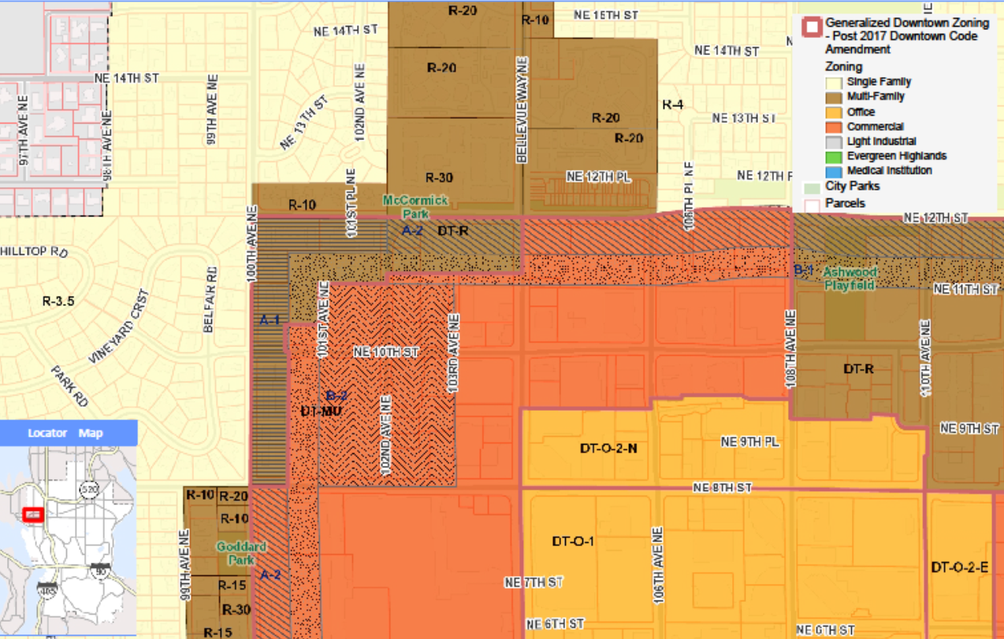
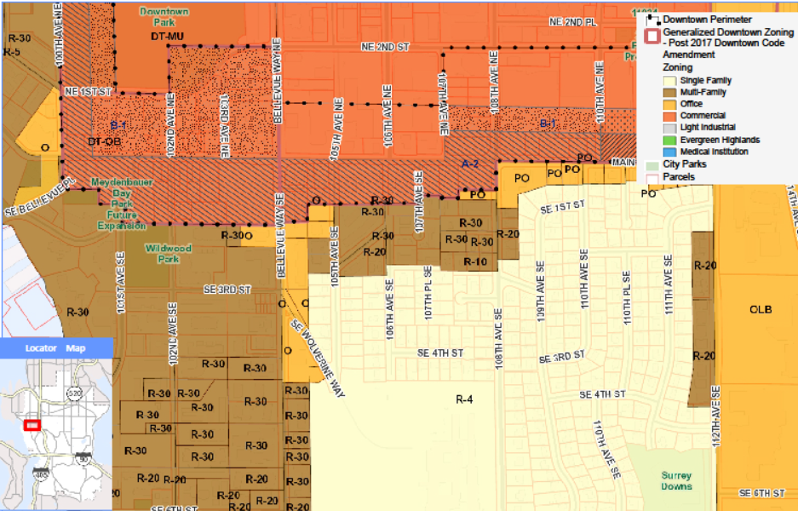
2019 Annual Comprehensive Plan Amendments
The Park in Bellevue (Existing Plan)

Slide 9
2019 Annual Comprehensive Plan Amendments
The Park in Bellevue
Staff Recommendation
This proposal does not meet all the Threshold Review criteria and should therefore not be included in the annual Work Program
Summary of Criteria Evaluation
The matter of a previously unknown, multi-part plan designation is inappropriately addressed in the existing Plan (A)
Downtown-like densities outside the Downtown raise policy issues outside the annual process (C)
Citywide consequences of any of this could not be reasonably reviewed with annual resources (D)
The proposal fails to demonstrate that explosive growth in the Downtown is a significantly changed condition (E)
The proposal is inconsistent with the city’s growth strategies locating growth within certain lines (G)

Slide 10
2019 Annual Comprehensive Plan Amendments
The Park in Bellevue
Public Comments
Fourteen public comments have been submitted on this application to date.

Slide 11
2019 Annual Comprehensive Plan Amendments
The Park in Bellevue
Threshold Review Study Session

Slide 12
Bellevue Technology Center
Bellevue Planning Commission
Threshold Review Public Hearings April 24, 2019
Nicholas Matz AICP

Slide 13
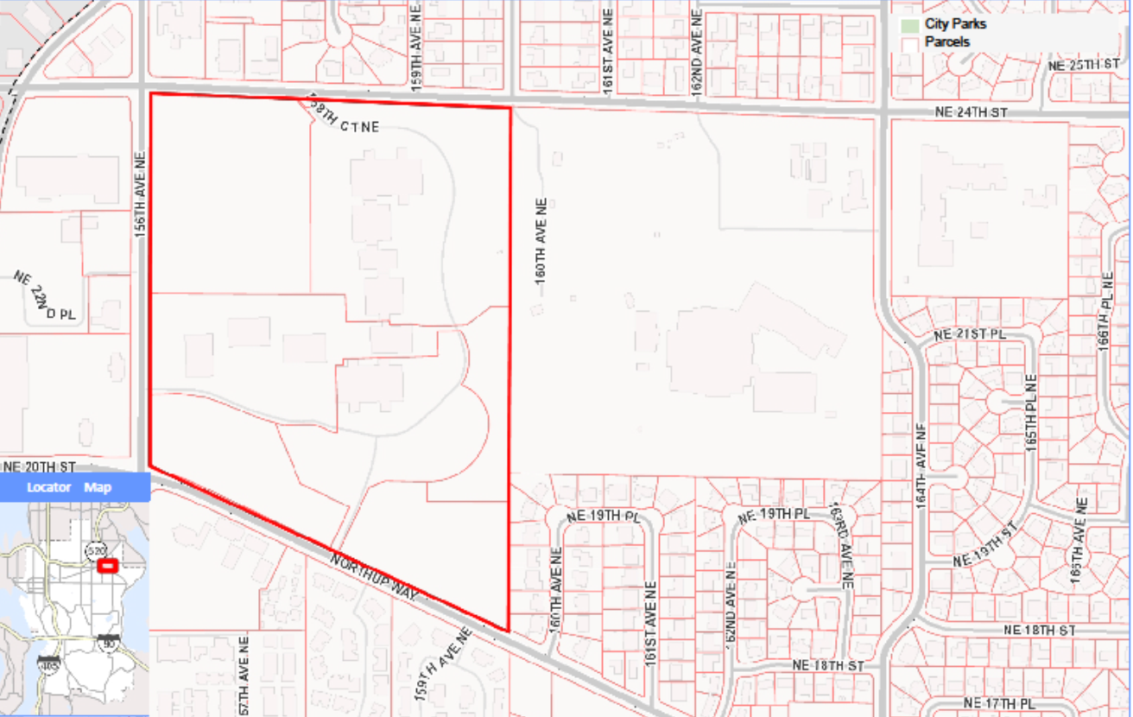
2019 Annual Comprehensive Plan Amendments
Bellevue Technology Center (Applicant)
O to MF-M (4.7 ac)
Seven policy amendments* to redevelop site (47 acres)
Three policy amendments directing city action:
Encourage TDM for TOD
Add improvements to the TFP for MMLOS
Neighborhood stability by mitigating regional trans. improvements
*TOD densities, affordable housing, neighborhood edges and conservation easements, multi-modal mobility, strengthen economic vitality

Slide 14
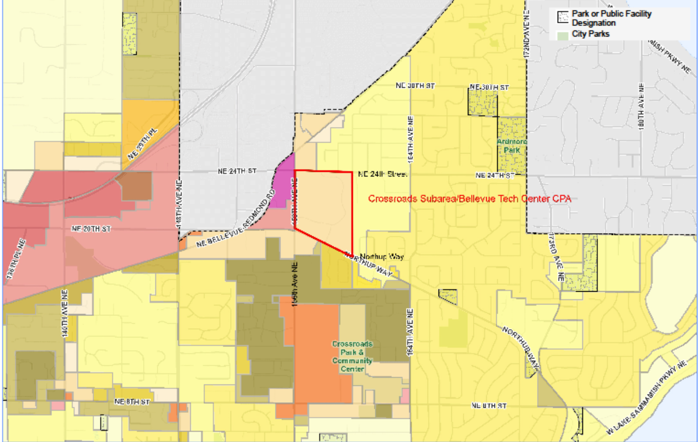
2019 Annual Comprehensive Plan Amendments
Bellevue Technology Center (existing Plan)

Slide 15
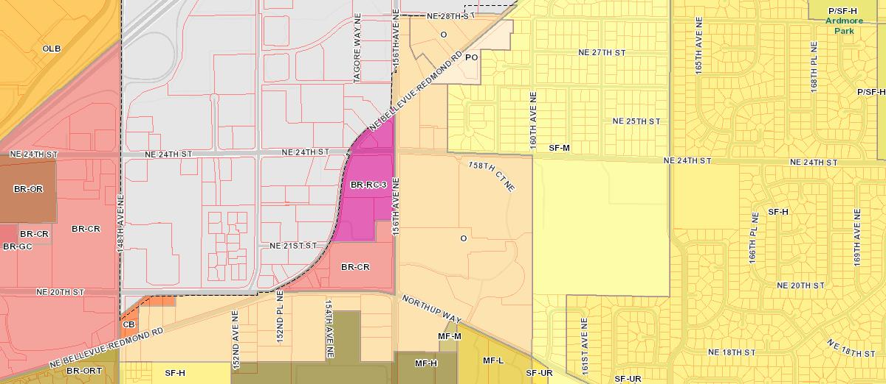
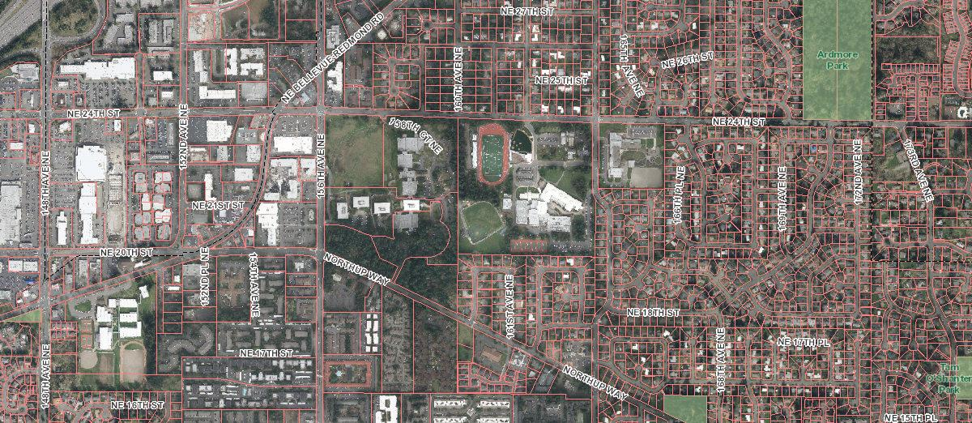
2019 Annual Comprehensive Plan Amendments
Bellevue Technology Center

Slide 16
2019 Annual Comprehensive Plan Amendments
Bellevue Technology Center
Staff Recommendation
This proposal does not meet all the Threshold Review criteria and should therefore not be included in the annual Work Program
Summary of Criteria Evaluation
The legislative history of this proposal consistently rejects the existing Plan as an appropriate place for amending site capacity regulations (A)
BelRed densities proposed outside of BelRed raise policy issues outside the annual process (C)
Citywide consequences of any of this could not be reasonably reviewed with annual resources (D)
The proposal fails to demonstrate that the city’s growth strategy is a significantly changed condition regarding this site’s proximity to other areas (E)
The proposal is inconsistent with the city’s growth strategies locating growth within certain lines (G)

Slide 17
2019 Annual Comprehensive Plan Amendments Bellevue Technology Center
Public Comments
Ninety-three public comments or inquiries from seventy-seven parties of record have been submitted on this application to date
An online petition has garnered over 2,100 names
A comment letter analyzing the application at length was signed by representatives of multiple neighborhood associations

Slide 18
2019 Comprehensive Plan Amendments Threshold Review and Geographic Scoping
Bellevue Technology Center
Threshold Review Study Session

Slide 19
2019 Comprehensive Plan Amendments
Bellevue Planning Commission
Threshold Review Public Hearings April 24, 2019

